Slide 1


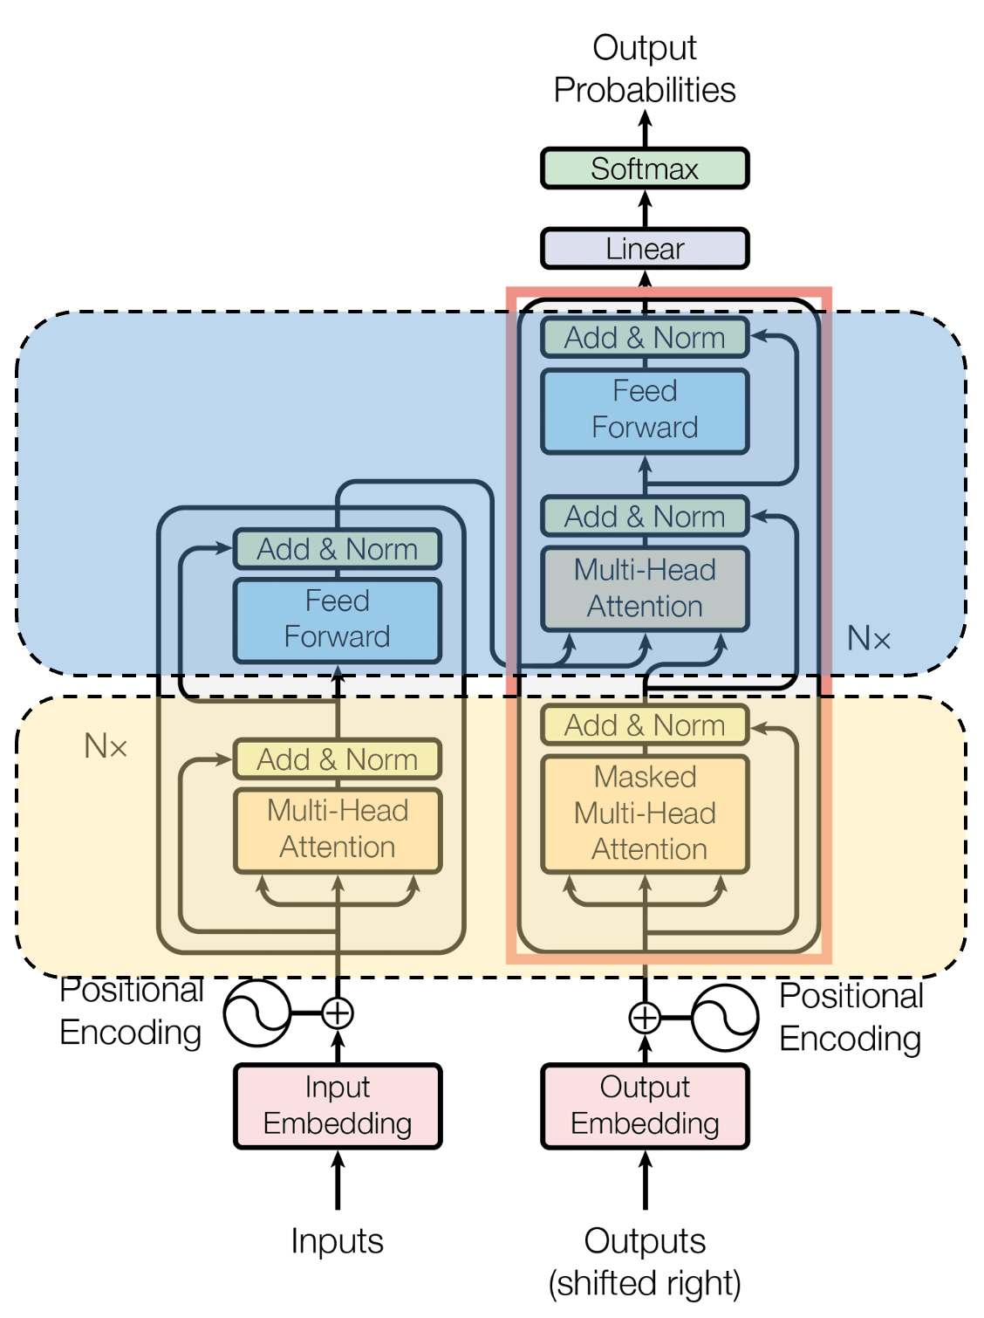
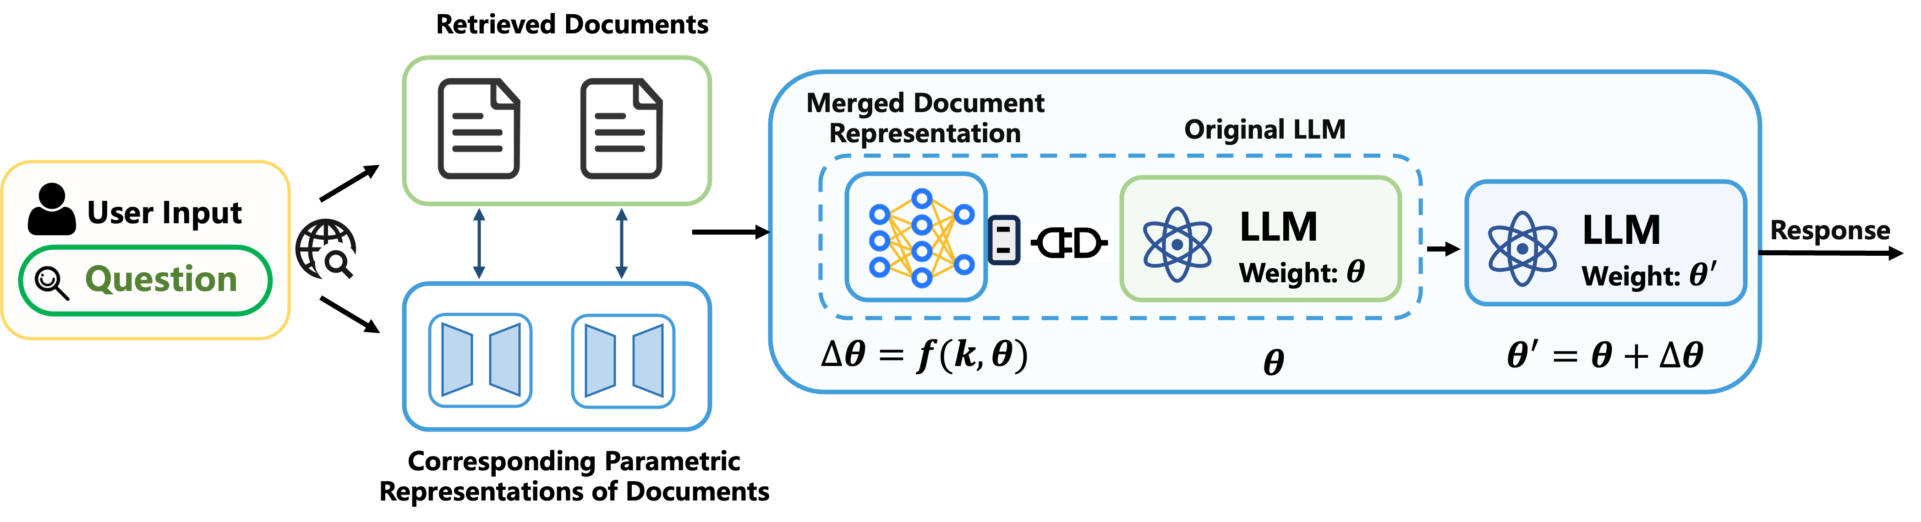
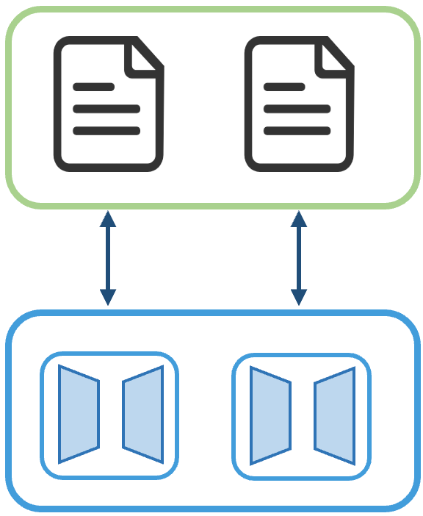



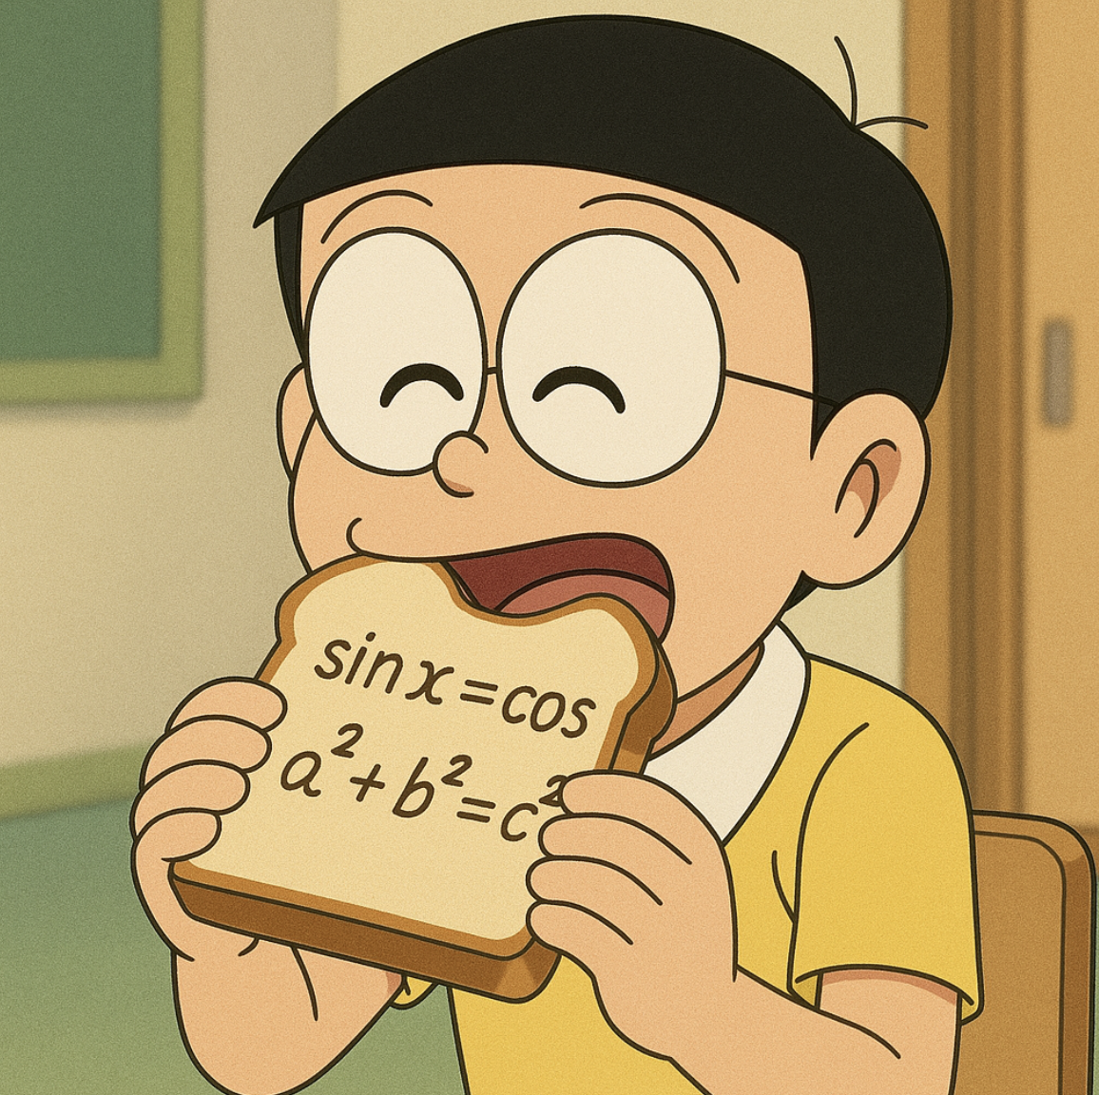
论文题目xxxxx
作者1、作者2、作者3
作者工作单位1、作者工作单位2
Background
Methodology
Retrieval Augmented Generation:
Overall Framework:
Offline Document Parameterization: Converting documents into parametric representations.
Online Inference: Retrieve, merge document parameters, and generate responses.
Existing RAG methods rely on the same paradigm for knowledge injection: In-Context Knowledge Injection
Despite being the dominant approach, In-context Knowledge Injection has several limitations:
Context Limitation
Document Augmentation:
Document Rewriting + QA Pair Generation:
Parametric Document Encoding:
Pluggable parameter-efficient fine-tuning components, e.g., LORA.
Training: Next token prediction for 1 epoch.
Only the input length is increased; all other settings are kept constant
→ LLM performance consistently decreases
Knowledge Integration
  LLMs store world knowledge in FFN layers.
  However, In-context Knowledge Injection operates only at the attention (key-value) level
Experimental Results
  As a result, knowledge provided through context is mechanistically different from internal parametric knowledge and thus cannot be utilized in the same way.
New RAG Paradigm: Parametric RAG
Instead of input context, PRAG injects retrieved knowledge directly into the LLM’s parameters
Efficiency Analysis
P-RAG Reduces Latency: 29%–36% faster than Standard RAG.
Combine Both Maintains Efficiency: Similar inference time as Standard RAG.
Memory Bread → Plug-in Module
Eating the Bread → Parameter Update
Digestion → Temporary (Inference-time)
Ablation Study:
Both Steps Are Essential: Removing rewriting and QA degrades performance.
QA Matters More: Removing QA causes a larger drop than removing rewriting.
Best Performance: Using both rewriting and QA achieves the highest scores.
Notes:
A1 poster template (lavendar)

