Slide 1


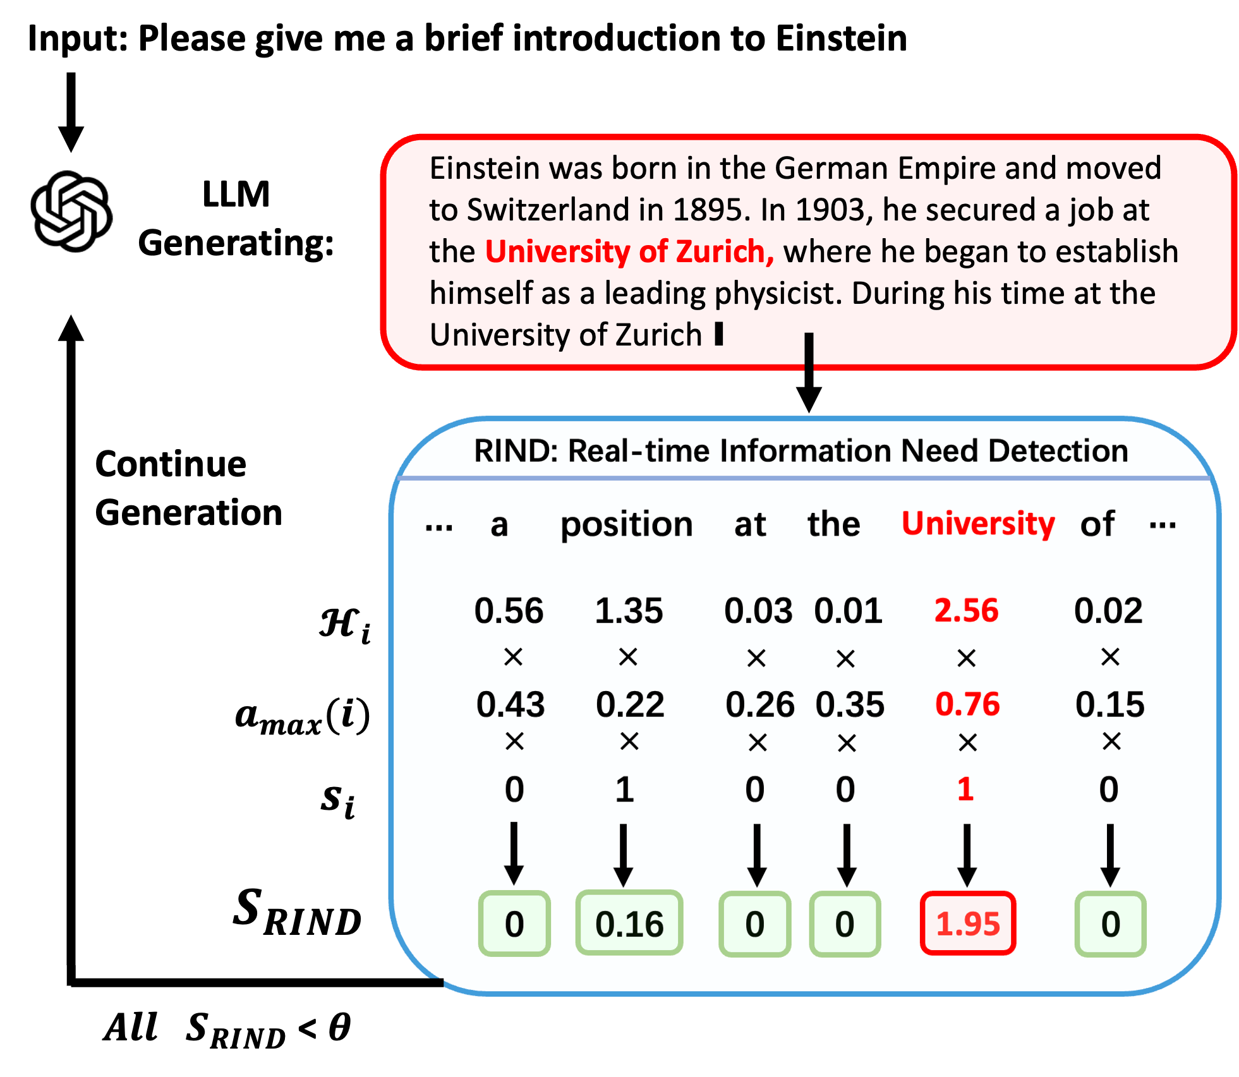
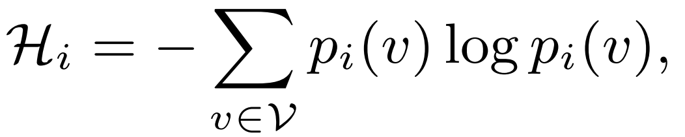
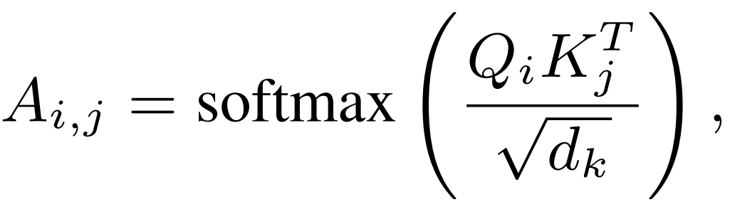
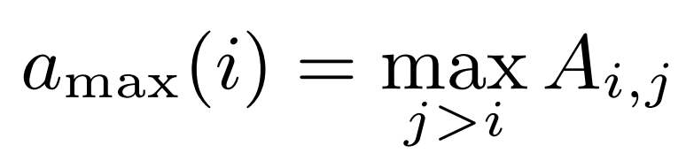
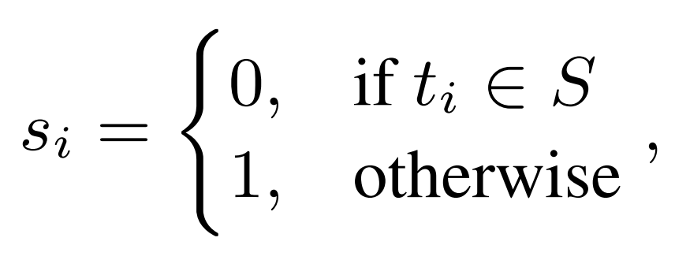
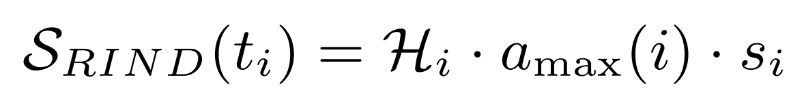
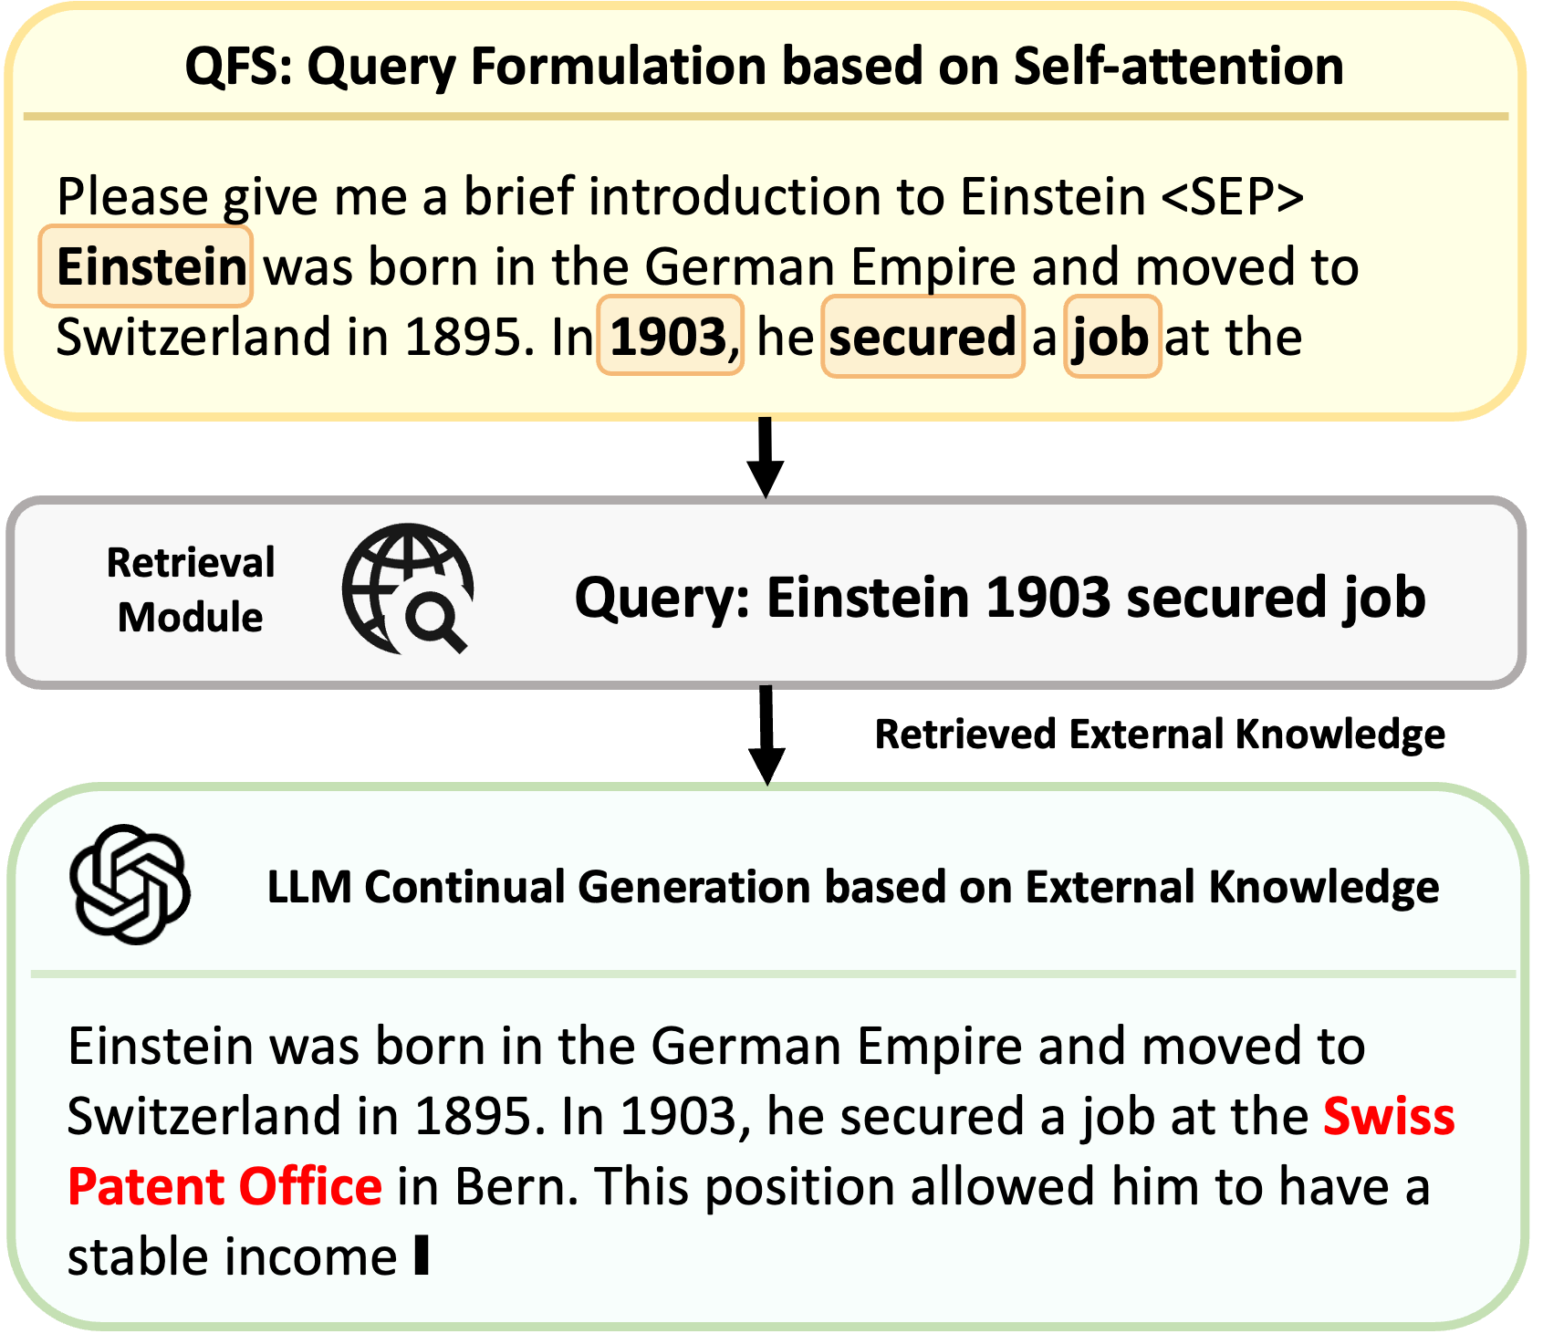
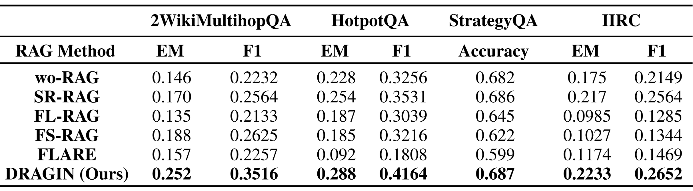
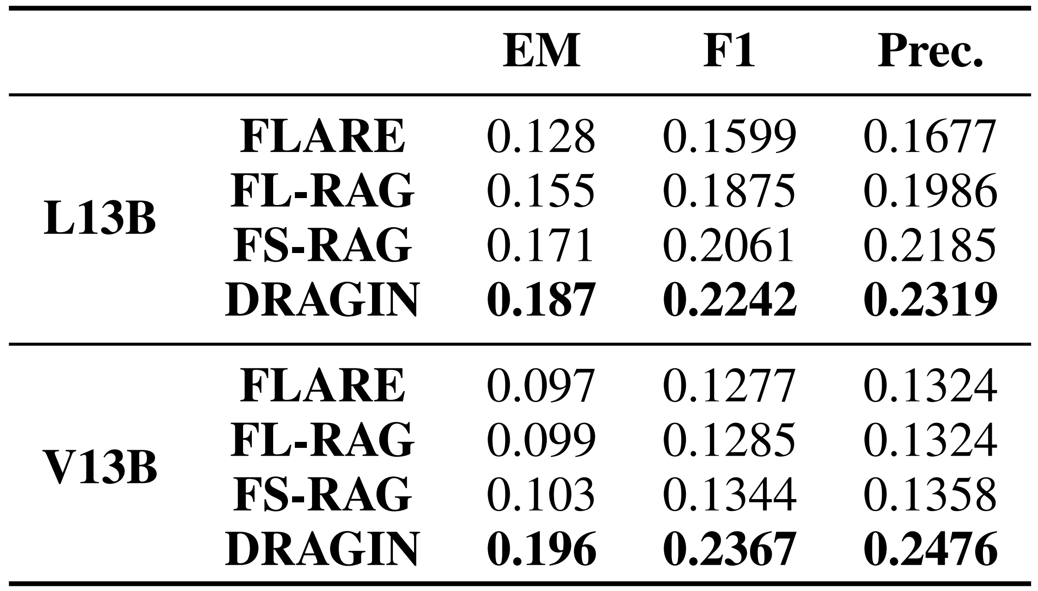
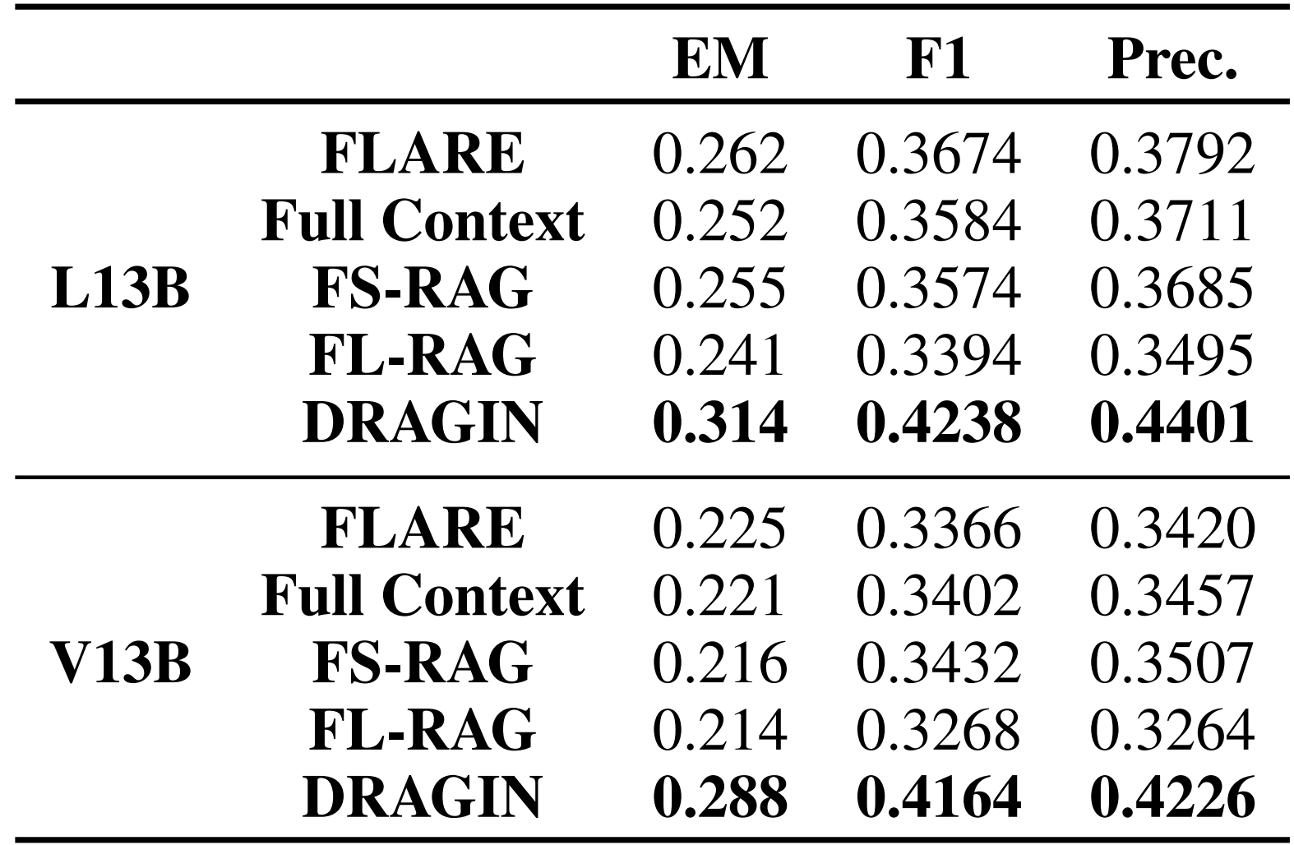
论文题目
xxxxxxxxx
xxx学校
作者1，作者2，作者3
Background
Methodology
LLMs have achieved great success across a variety of tasks, leading to their application in solving complex problems such as:
Multi-hop Reasoning
Long-text Generation
Our Proposed DRAGIN Framework:
Deciding When to Retrieve based on:
Uncertainty: the entropy of token probabilities distributed across the vocabulary.
Significance: the maximum attention to this token in the following text.
Semantic: whether this token has semantic meaning.
Previous work has shown that Retrieval Augmented Generation (RAG) can significantly enhance the performance of LLMs, mitigating LLM’s hallucinations.
RAG frameworks can be categorized into two types:
Single-Round RAG: Before LLM inference, it retrieves external knowledge based on the initial instruction.
Dynamic RAG: During LLM inference, it actively decides when and what to retrieve.
Motivation
Why do we need Dynamic RAG for complex tasks?
Simple Tasks: The information needs of LLMs can be determined based on the initial instruction.
Complex Tasks: The information needs of LLMs may change during the inference process. For example:
What to Retrieve: For the position that require external knowledge, the query is generated based on the Attention to the entire preceding context.
Step 1: Extract the last layer’s attention scores for each token.
Step 2: Sort these tokens by attention score​ and save the top 𝑛.
Step 3: Construct the query using the top n tokens.
Step 4: Add the retrieved knowledge to the context, then let the LLM generate from the truncation point.
Instruction: Write a complete commentary on Argentina's victory at the Qatar World Cup
LLM: Argentina's victory at the 2022 FIFA World Cup in Qatar was a triumph that encapsulated drama, passion, and a storied journey back to the pinnacle of world football. XXX once said: there is only one true heroism in the world: to see the world as it is, and to love it.
Initial Information Needs:
  Argentine team
  Qatar World Cup
Information Needs During Inference:
“There is only one true heroism..."
→ Who said this quote?
Research Question:
How to address the information needs of an LLM during its inference process?
When to trigger retrieval?
What to retrieve when retrieval is triggered?
Experimental Results
The overall experimental results of DRAGIN and other baselines on four benchmarks. The best results are in bold.
Triggering retrieval when LLMs do not need retrieval:
→ Increases unnecessary computation
Retrieved information can’t meet the information needs of LLMs:
→ Introduces noise or irrelevant information
Ablation Study
Query Formulation (What)
作者信息
Timing of Retrieval (When)
Email: oneal2000@126.com
Notes:
A1 poster template (blue)

